Slide 1


Lecture 05 Two Dimensional Graphics Part 4
Visualizing Real Data

Slide 2
Introduction
Visualizing data is a common request in some applications.
Graphical data is easier to stand than text
Programmers should have the skill at data visualization
Demo: Creating Line Chart for a time series
Notes:
- Visualizing ~ Hình dung

Slide 3
Contents
Normal Coordinates versus Device Coordinates
Expected Shape
Mapping a Real Point to Device Point
Drawing Area in a Component

Slide 4
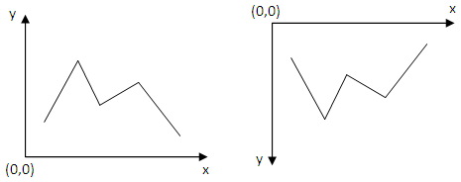
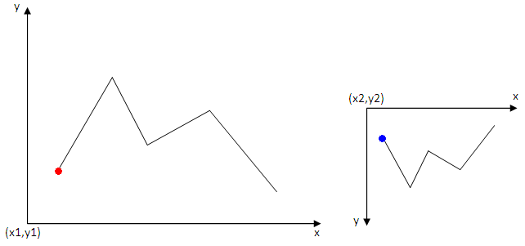
Normal Coordinates versus Device Coordinates
Normal Coordinates
Device Coordinates
?
Mapping
Normal Coordinates
Device Coordinates

Slide 5
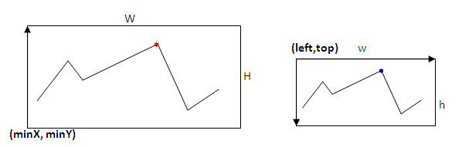
Expected Shape
Common used shape
The shape will be on device
A mapping is needed to exchange a real point to an on-device point

Slide 6
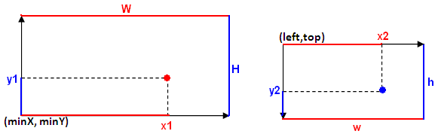
Mapping a Real Point to Device Point
Normal Coordinates
Device Coordinates
Properties of the point must be preserved
Computing x2
(x1-minX)/W = (x2-left)/w → x2 = left + (x1-minX)*w/W
Let C_{W} = w/W
x2 = left + C_{W}(x1-minX)
x2 = C_{w}x1 + left – C_{w}minX

Slide 7
Mapping a Point
0
Normal Coordinates
Device Coordinates
top
Properties of the point must be preserved
Computing y2
(y1-minY)/H = (top+h-y2)/h
(y1-minY)*h/H = top +h –y2
Let C_{h} = h/H
y2 = top + h – C_{h}(y1-minY)
y2 = -C_{h}y1 + C_{h}minY + top + h
y2
h

Slide 8
Mapping a Point
x2 = C_{w}x1 + left – C_{w}minX
x2 = C_{w}x1 + C1
y2 = - C_{h}y1 + C_{h}minY + top + h
y2 = - C_{h}y1 + C₂
Classes can be use in Java API:
java.awt.Dimension: An area on component
java.awt.geom.AffineTransform for mapping a point in one window to another

Slide 9
Drawing Area in a Component
y
Drawing Area
x
Gaps should be reserved:
Gaps between component’s boundaries and coordinates' boundaries
Gaps between coordinates' boundaries and drawing boundaries
Notes:
- Boundaries ~ Ranh giới

Slide 10
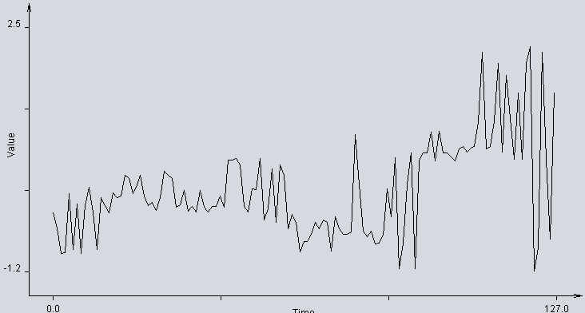
Demo: Creating Line Chart
A time series is a sequence of data points, typically consisting of successive measurements made over a time interval. Examples of time series are electrocardiograms (ECG), ocean tides, counts of sunspots, and the daily closing value of the Dow Jones Industrial Average. Time series are very frequently plotted via line charts. (Wikipedia)
Notes:
- Electrocardiogram (ECG) ~ Điện tâm đồ
Ocean tide ~ Thuỷ triều
Counts of sunspots ~ Vết đen mặt trời

Slide 11
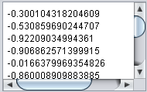
Demo…
This demonstration depicts how to draw a line chart for a time series.
Time series is usually stored as a list of values, time intervals are default. Example:
They can be considered as points:
(0, -0.300104318204609)
(1, -0.530859690244707)
(2, -0.92209034994361)
(3, -0.906862571399915)
….
Notes:
- Depict ~ Mô tả

Slide 12
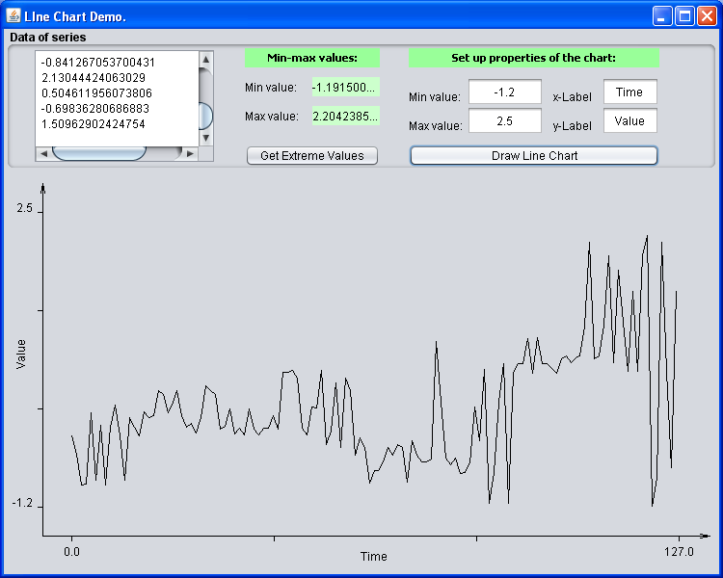
Demo …
GUI

Slide 13
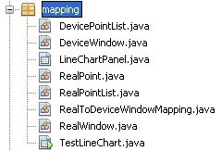
Demo …
Class Design
A list of integral points on a device
An area in device coordinates
Panel contains ability for drawing a line chart which representing a list of real points
A point in real coordinates
A list of real points
Mapping a real window to a device window
An area in real coordinates
GUI program

Slide 14
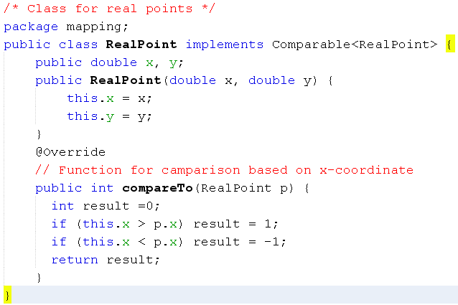
Demo.: Code

Slide 15
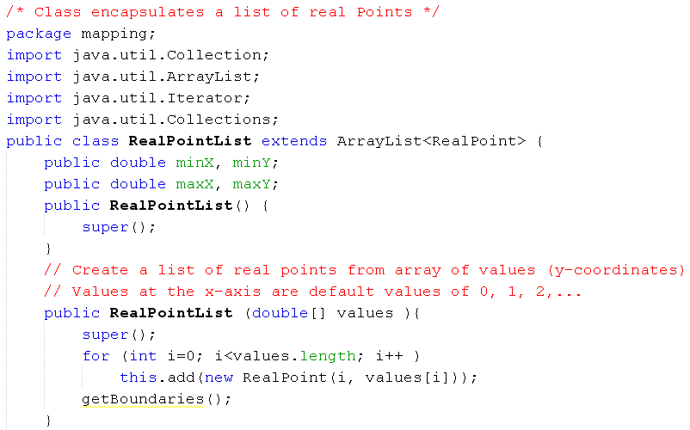
Demo.: Code

Slide 16
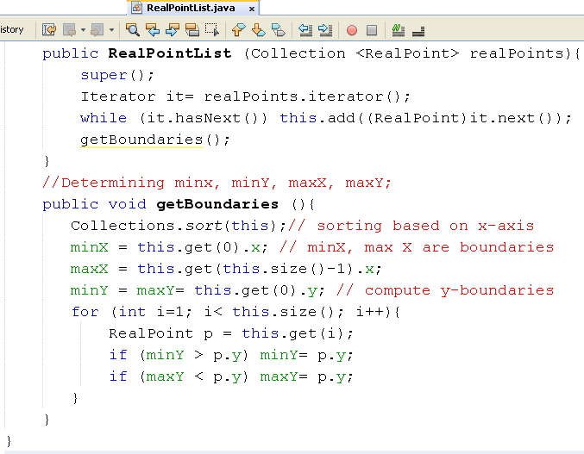
Demo.: Code

Slide 17
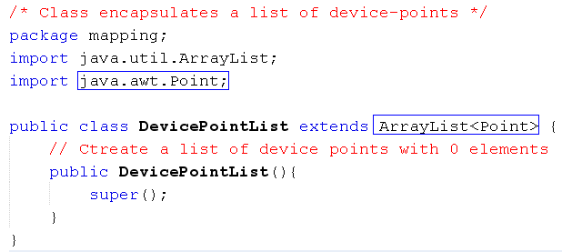
Demo.: Code

Slide 18
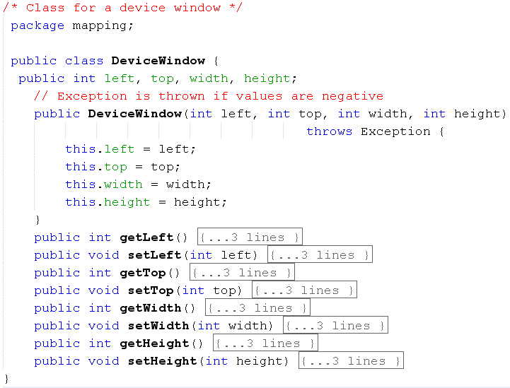
Demo.: Code

Slide 19
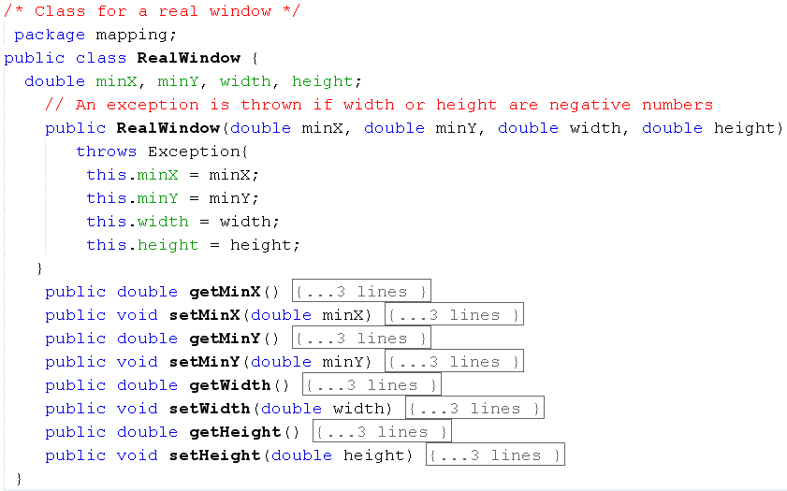
Demo.: Code

Slide 20
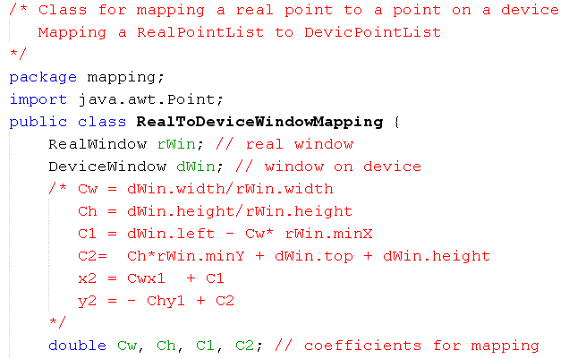
Demo.: Code

Slide 21
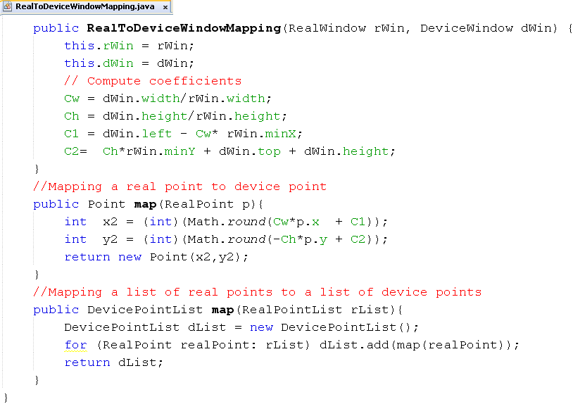
Demo.: Code

Slide 22
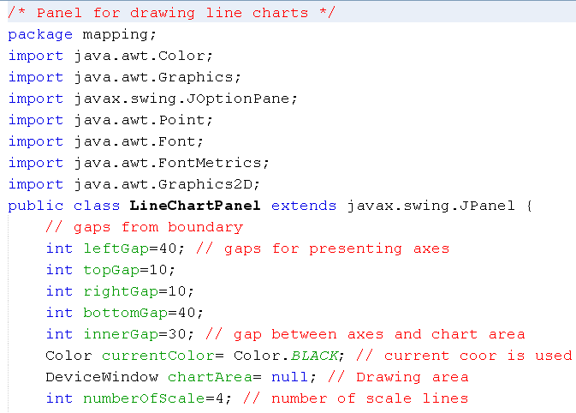
Demo.: Code

Slide 23
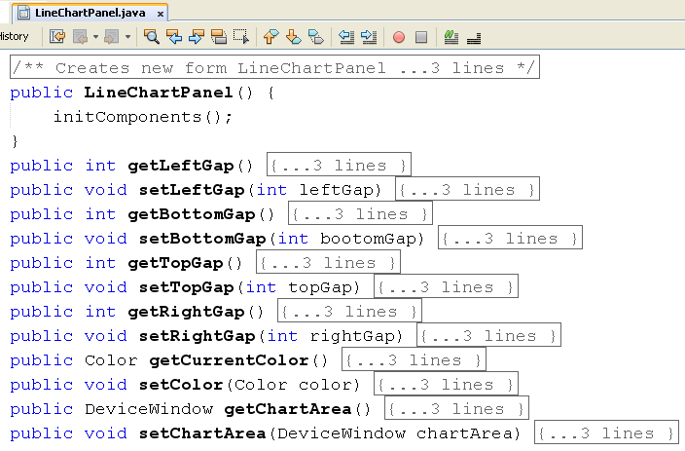
Demo.: Code
Constructor, getters, setters

Slide 24
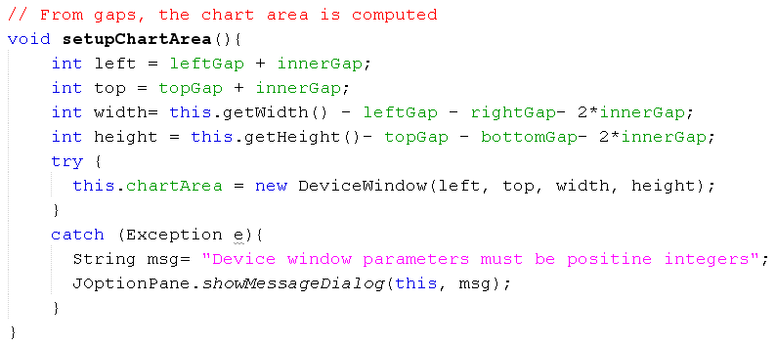
Demo.: Code

Slide 25
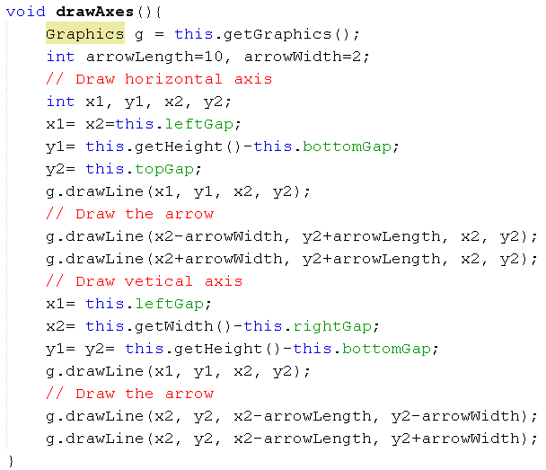
Demo.: Code

Slide 26
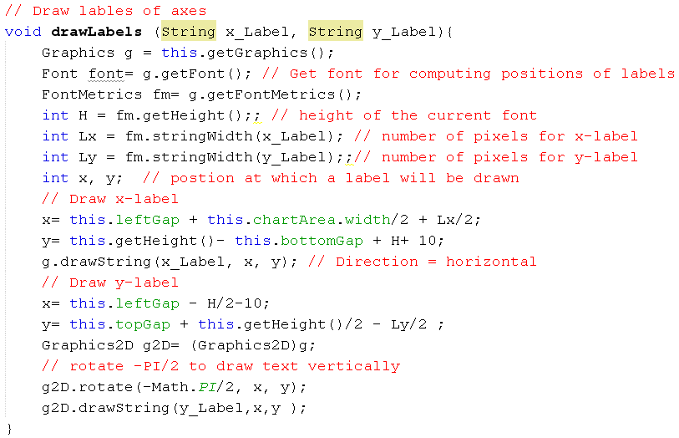
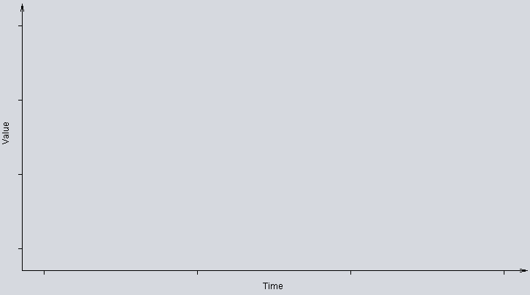
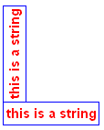

Demo.: Code

Slide 27
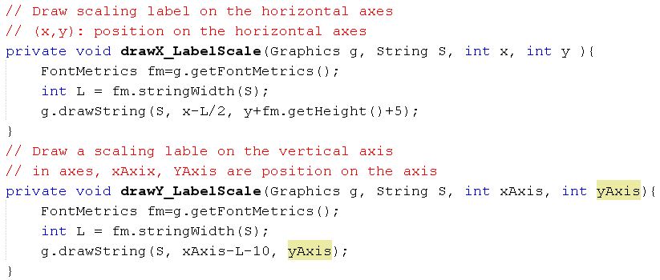
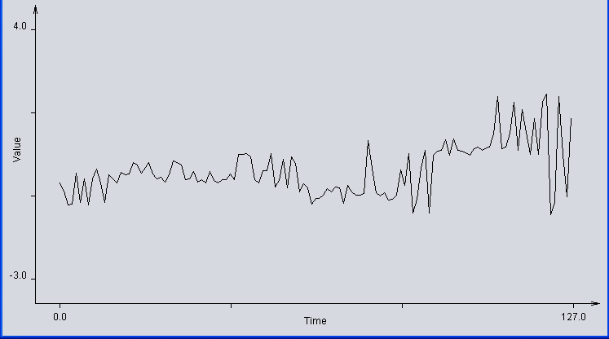
Demo.: Code

Slide 28
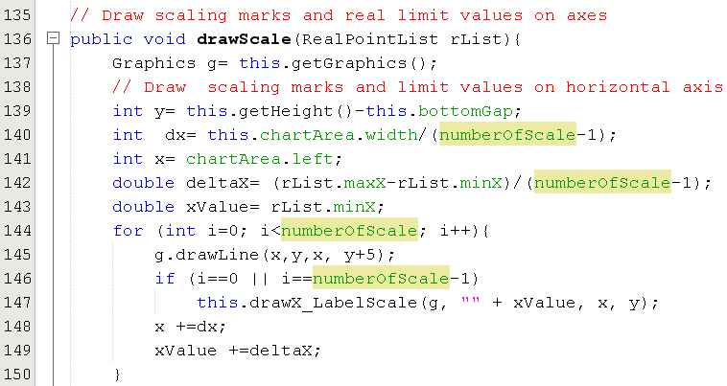
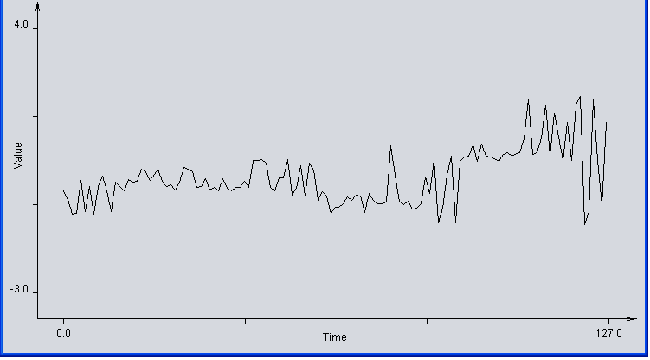
Demo.: Code

Slide 29
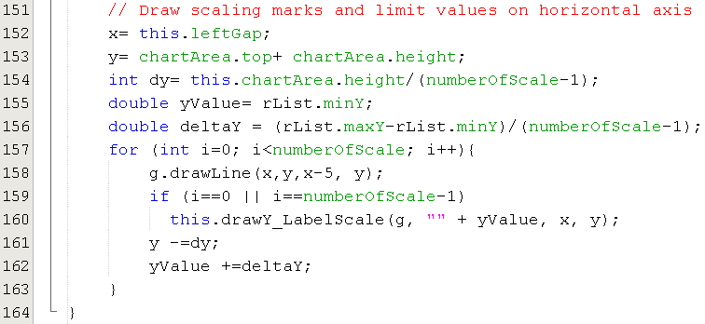
Demo.: Code
The method drawScale(..) contd.

Slide 30
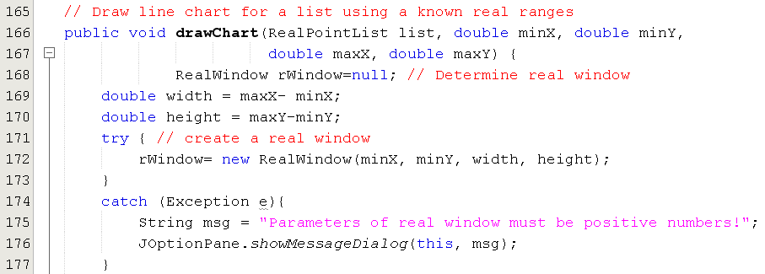
Demo.: Code

Slide 31
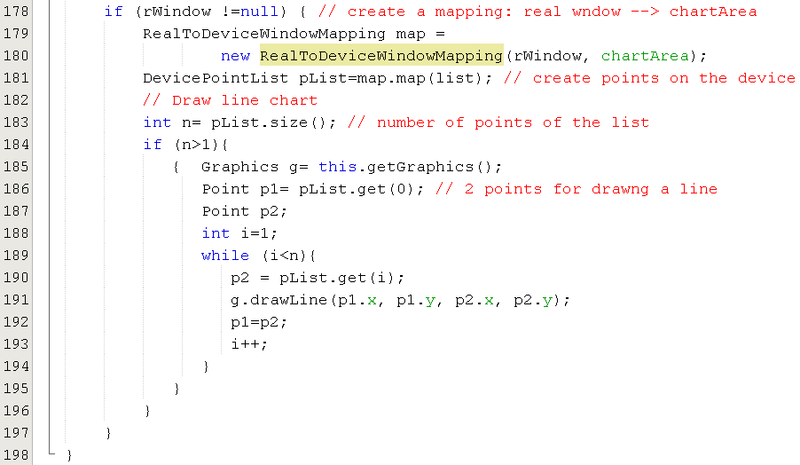
Demo.: Code
The method drawChart(…) contd.

Slide 32
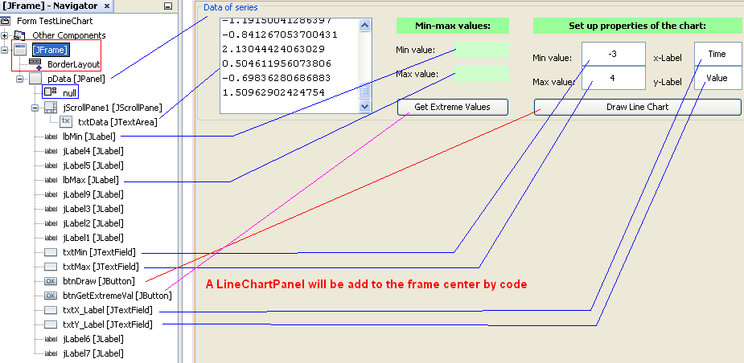
Demo.: Code
TestLineChart.java

Slide 33
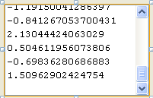
Demo.: Code
0.267999733581741
-0.0564639730644435
-0.191168727157551
-0.147829126965571
-0.273163491385384
-0.0728626322272284
0.318367962208834
0.262143372601077
0.211775143973984
-0.220452326788983
-0.184140571878031
0.0302161899464127
-0.281362462021154
-0.213424660980765
-0.295418935737296
0.0302161899464127
-0.22279509960119
-0.295418935737296
-0.213424660980765
-0.213424660980765
-0.0552926192897602
-0.220452326788983
0.494070049468728
0.494070049468728
0.511640111353326
0.426131758957036
-0.213424660980765
-0.295418935737296
0.053643037020138
0.0407579986572305
0.511640111353326
-0.418410511029192
-0.241536955784644
0.361707056613802
-0.447694110660624
0.426131758957036
0.257457990133764
-0.541402086321088
-0.327045308180934
-0.447694110660624
-0.903348493760155
-0.744045000400206
-0.744045000400206
-0.636281203652004
-0.453550961112591
-0.541402086321088
-0.418410511029192
-0.447694110660624
-0.879921744580691
-0.3680426087163
-0.541402086321088
-0.636281203652004
-0.636281203652004
-0.594112598289085
0.879443532401462
0.119238603666753
-0.57771384123204
-0.664393661612984
-0.57771384123204
-0.770985990376532
-0.761615551756108
-0.64916588306929
0.059499871156395
-0.3680426087163
0.523353812257261
-1.14816033951639
-0.761615551756108
0.119238603666753
0.603005803672886
-1.14816033951639
0.47650015074123
0.595977648393366
0.603005803672886
0.919268875480871
0.485870099890352
0.923954421105285
0.603005803672886
0.595977648393366
0.538581101329652
0.485870099890352
0.656887620468437
0.695542311348697
0.618233092745278
0.67328588805418
0.695542311348697
1.06803013592154
2.13044424063029
0.656887620468437
0.695542311348697
1.08794378640385
1.95825476259625
0.618233092745278
1.76849652793441
1.11722754919238
0.504611956073806
1.50962902424754
0.504611956073806
1.95825476259625
2.20423856580844
-1.19150041286397
-0.841267053700431
2.13044424063029
0.504611956073806
-0.69836280686883
1.50962902424754
Property Text:
-0.300104318204609
-0.530859690244707
-0.92209034994361
-0.906862571399915
-0.0166379969354826
-0.860008909883885
-0.175941438085159
-0.92209034994361
-0.191168727157551
0.0817553481397268
-0.300104318204609
-0.860008909883885
-0.0728626322272284
-0.191168727157551
-0.300104318204609
-0.00726706378588532
-0.0740340023176218
-0.0564639730644435
0.262143372601077
0.211775143973984
-0.0166379969354826
0.123924067712617

Slide 34
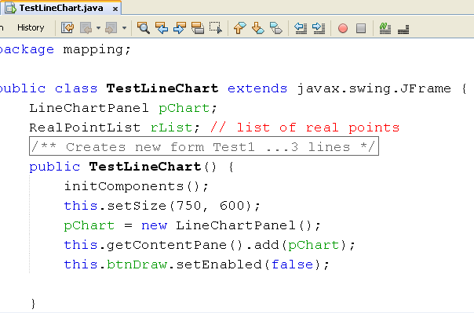
Demo.: Code

Slide 35
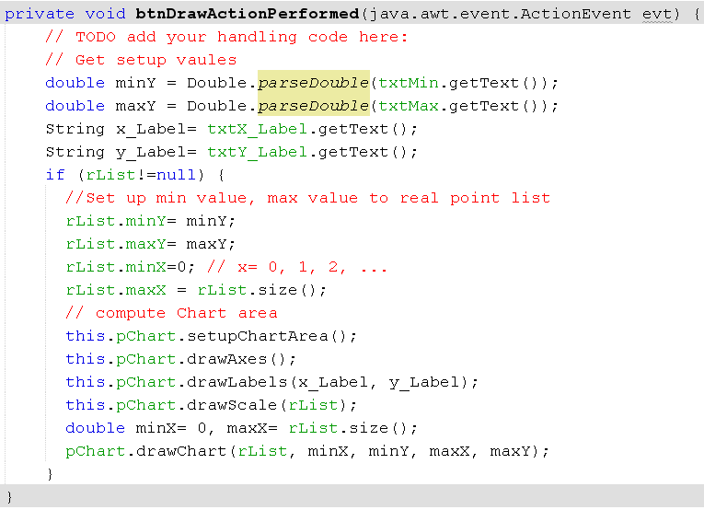
Demo.: Code

Slide 36
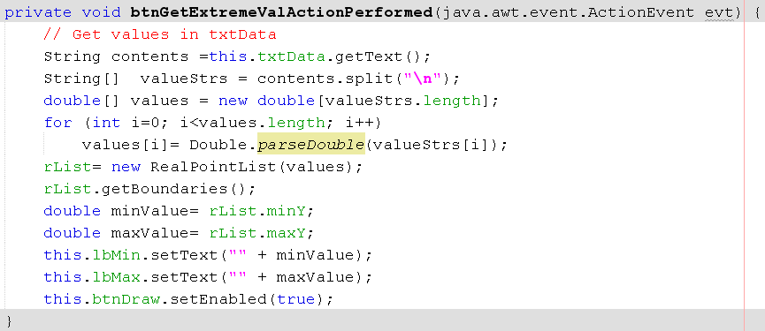
Demo.: Code

Slide 37
Summary
Normal Coordinates versus Device Coordinates
Expected Shape
Mapping a Real Point to Device Point
Drawing Area in a Component

Slide 38
Thank You

